Slide 1
Contact Management System Project
Name: Aditya Anal
College Name:MNNIT(Allahabad)
Intern Profile: Python Developer
Intern Id’s:OL/TP2269
Company Name:Techplement Pvt Ltd.

Slide 2
Tasks:Build a Contact Management System
Develop a command-line contact management system using Python.
Implement functionalities such as adding contacts, searching for contacts by name, and updating contact information.
Ensure proper error handling and data validation.
Implement a basic contact management system using dictionaries or lists to store contact information and simple file I/O for data persistence.

Slide 3
Required Tools:
I used VS Code for coding.
I used Python Language for conding.
I used the XAMPP for development.
I used XAMPP to set up and manage MySQL databases for my projects.

Slide 4
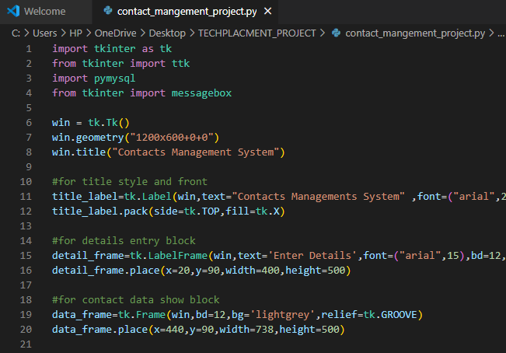
Step(1):Create a GUI

Slide 5
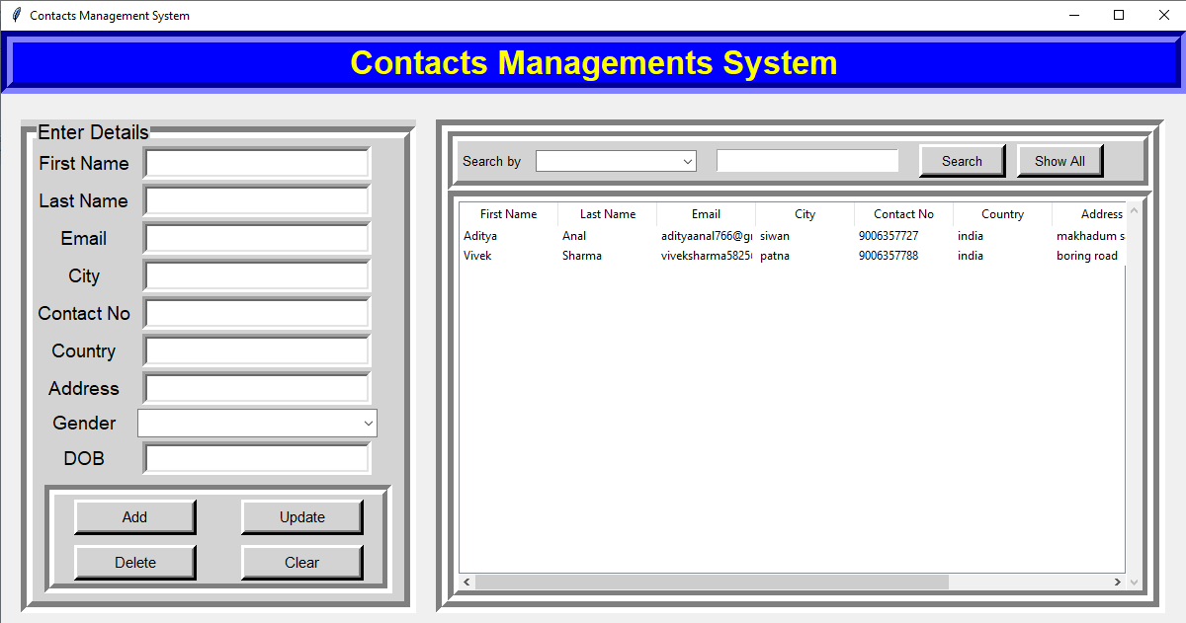
See user interface

Slide 6
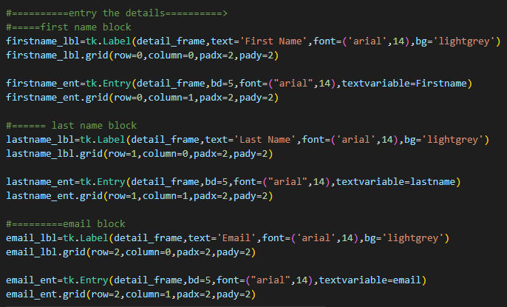
Take input form user & Input Block

Slide 7
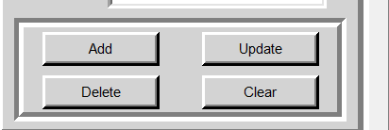

Add Buttom functionality

Slide 8
Work of button:
Add button is uesd to add tha data.
Update button is used to modifiy the data 0r change in data.
Clear button is uesd to clear the data show in entry box.
Delete button is used to delete the record in database.
Search button is uesd to sreaching the particular meaning
Show All button is uesd to show all records represent in database.

Slide 9
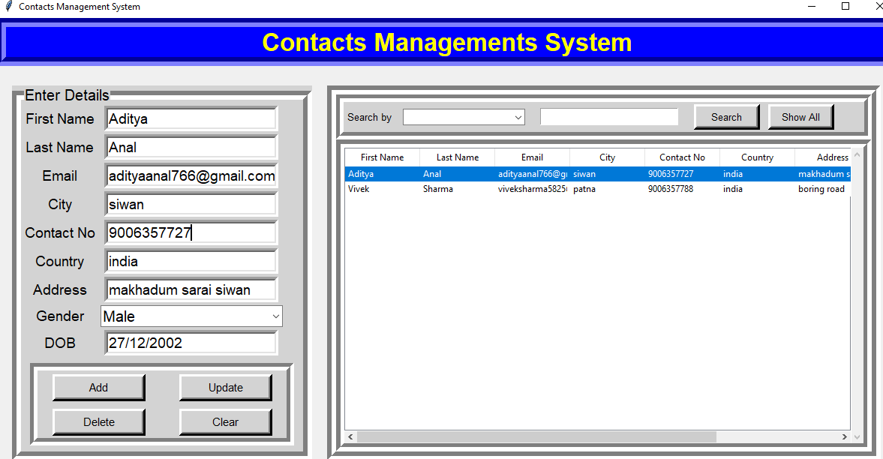
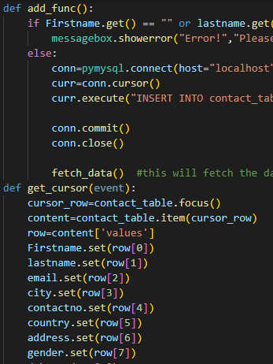
Add function:

Slide 10
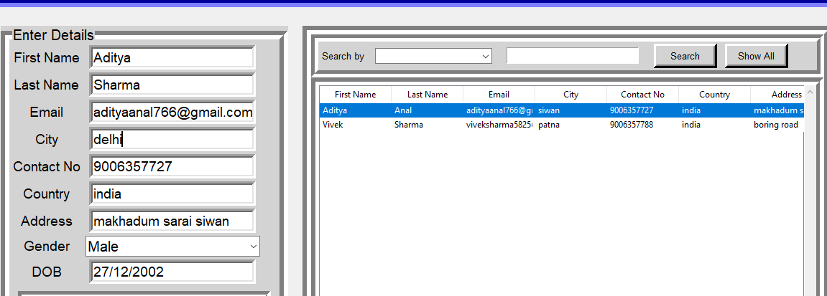
Update Function:
Example :Change in Lastname and City

Slide 11
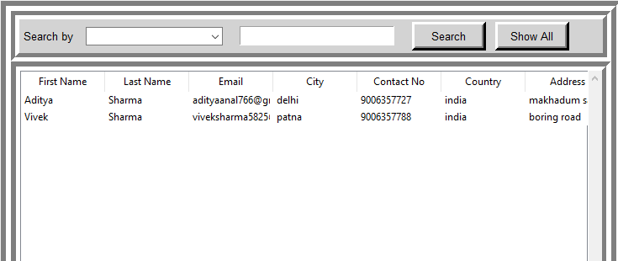
After change see results:

Slide 12
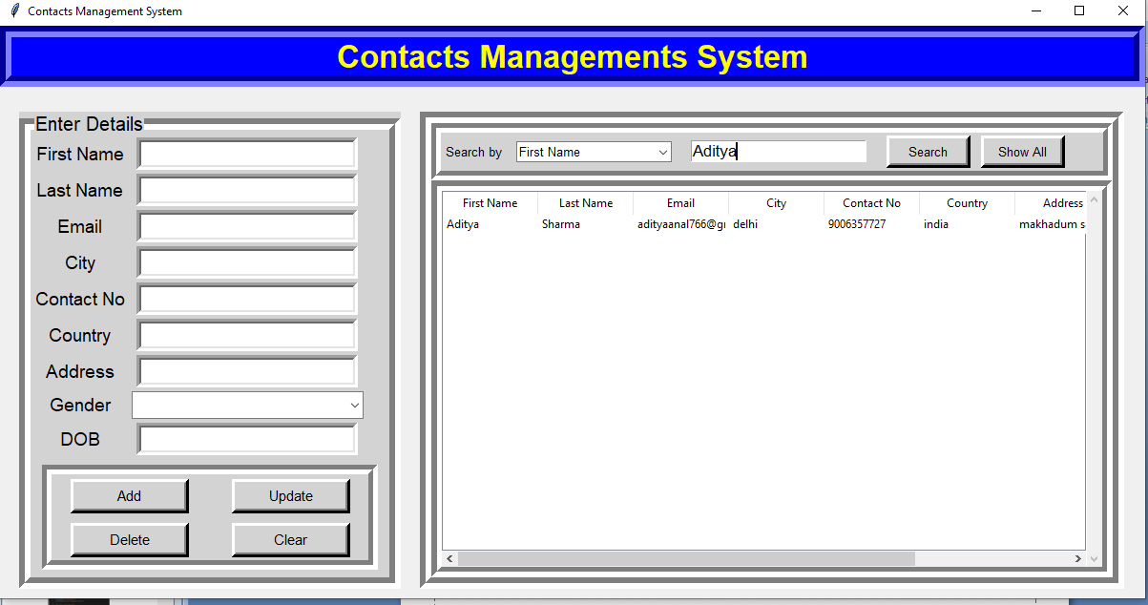
Searching function:
Example: Searching by Firstname

Slide 13
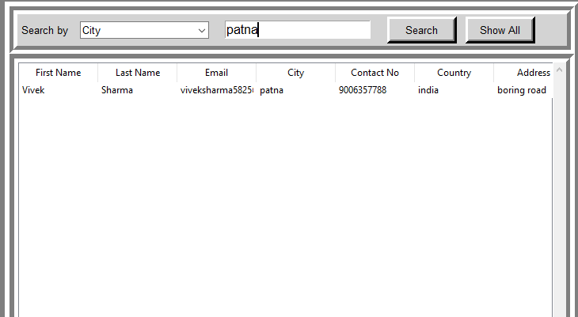
Take anothor example for searching:
Example: searching by city

Slide 14
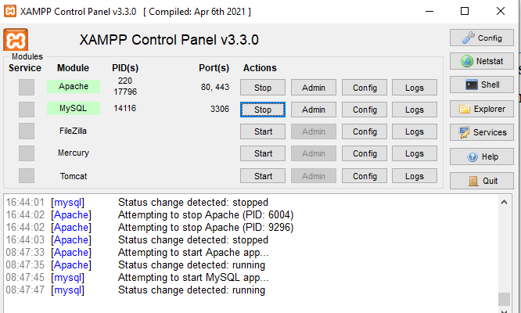
Database Management:
Firstly start the apache server and mysql server
Enter //localhost/phpmyadmin/ go to where data will manage and show all record.

Slide 15
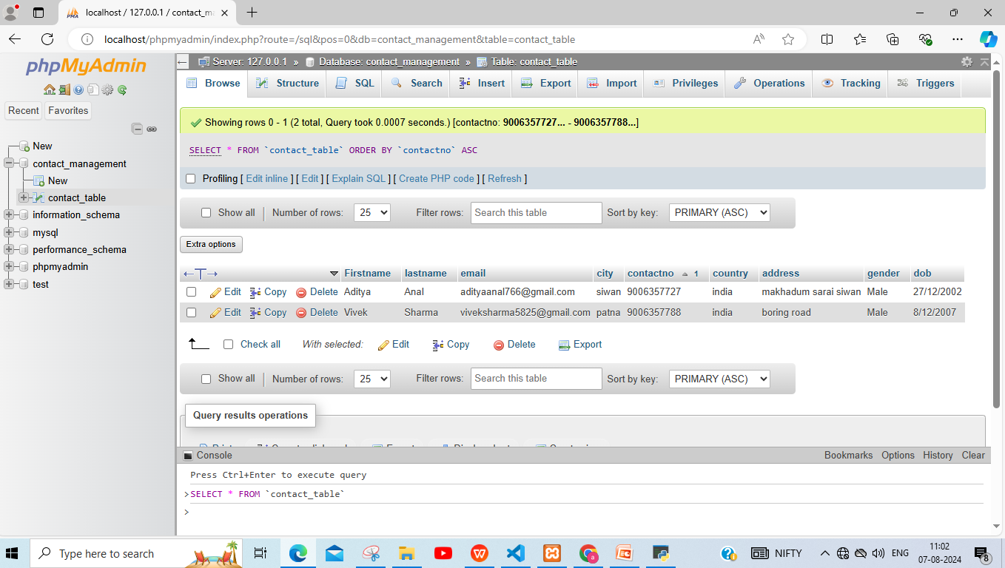
Show :/localhost/phpmyadmin/

Slide 16
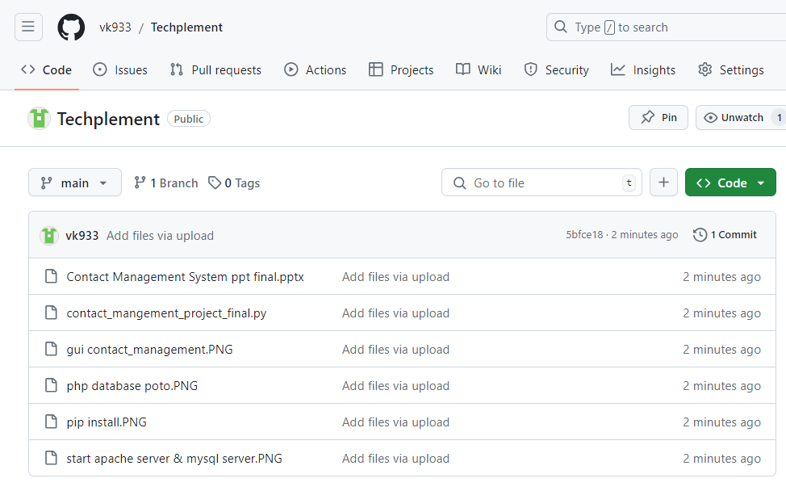
Last step:put all the result github
Link::https://github.com/vk933/Techplement

